Slide 1

Computer Vision (Course Code: 4047)
Module-1:Lecture-1: INTRODUCTION TO COMPUTER VISION
Gundimeda Venugopal, Professor of Practice, SCOPE

Slide 2
Course Objectives
Identify basic concepts, terminology, theories, models and methods in the field of computer vision
Describe basic methods of computer vision related to multi-scale representation, edge detection and detection of other primitives, stereo, motion and object recognition.
Choose appropriate computer vision methods for edge detection, object recognition, filtering etc.
Develop and apply computer vision techniques for solving practical problems.
Acquire good and practical skills in computer vision.

Slide 3
Topics Covered
Computer vision applications
Image Representation and Feature Extraction
Using Python, Tensor Flow, and OpenCV/MATLAB to process images
Image classification models
Custom image classifiers

Slide 4
What is Computer Vision?

Slide 5
What is Computer Vision?
Computer vision is a field of artificial intelligence (AI) that uses machine learning and neural networks to teach computers and systems to derive meaningful information from digital images, videos and other visual inputs—and to make recommendations or take actions when they see defects or issues.
The goal of computer vision is to interpret / understand images/videos
Note: In Image processing: Image In → Image Out

Slide 6
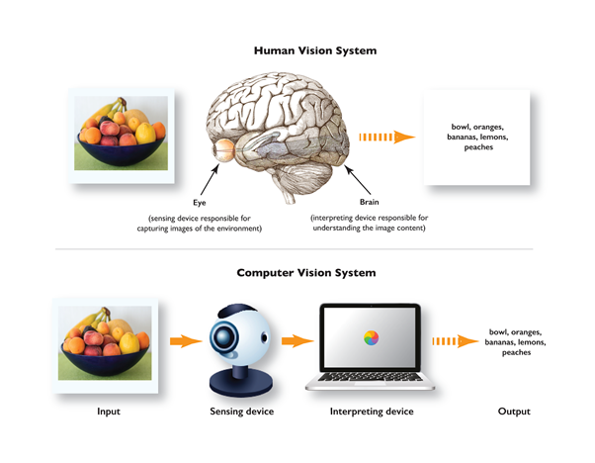

Slide 7

What a person sees
Why are we able to interpret this image?

Slide 8
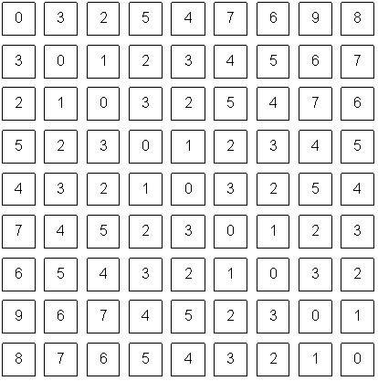
What a computer sees

Slide 9
Computer Vision Progress
How we teach computers to understand pictures | Fei Fei Li
https://www.pbslearningmedia.org/resource/computer-vision-crash-course-cs/computer-vision-crash-course-cs/
Notes:
https://www.kaggle.com/c/imagenet-object-localization-challenge/overview/description
2+ million files, 167.62 GB,

Slide 10
Computer Vision Challenges

Slide 11
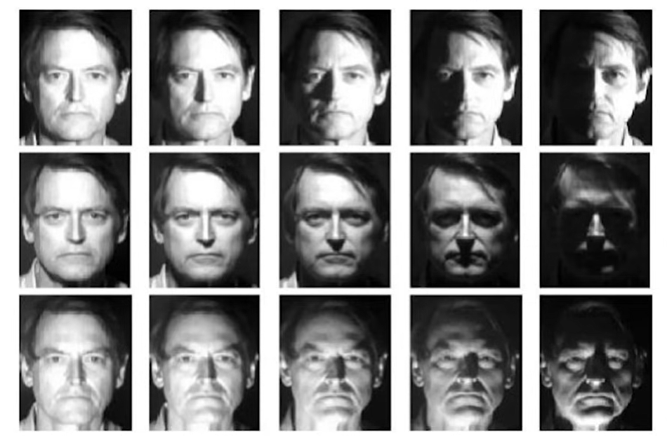
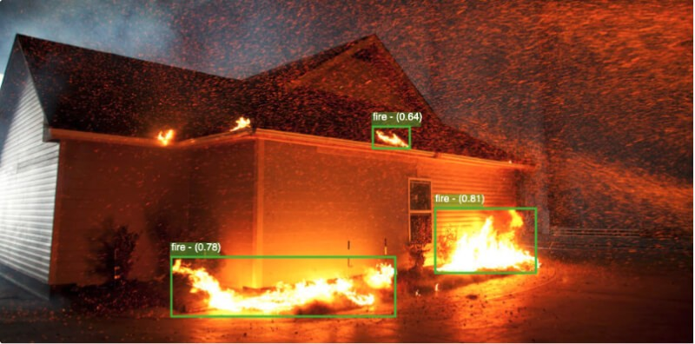
Illumination Variability
Variable lighting condition
Varying amounts of light in other parts of the combined with shadows and highlights distort the appearance of objects
Different types of light (e.g., natural, artificial, direct, diffused) can create other visual effects
Humans can easily adjust to different lighting conditions, computer vision systems struggle

Slide 12
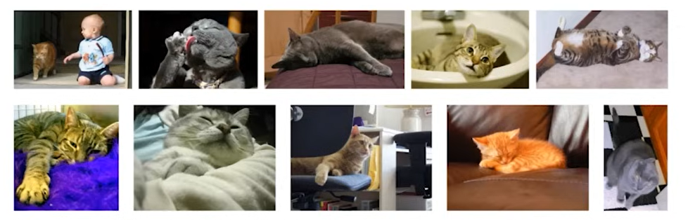
Pose Variability
Different Colour and texture
Rotated
Truncated
Deformed

Slide 13
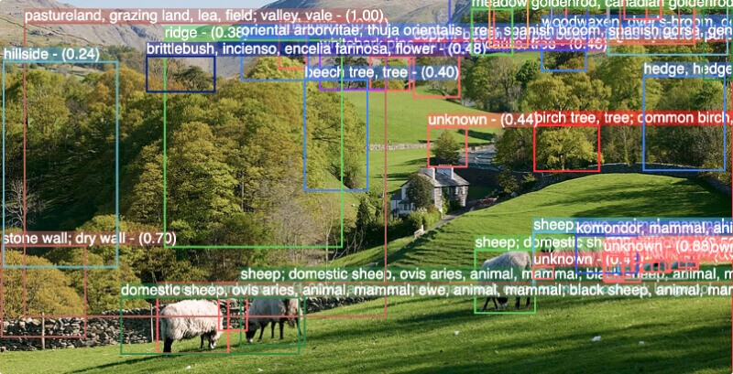
Perspective and scale variability
Objects can appear differently depending on their distance, angle, or size in relation to the camera.
This variability in perspective and scale presents a significant challenge for computer vision systems
In remote sensing applications, accurate object detection from aerial images is more difficult due to the variety of objects that can be present, in addition to significant variations in scale and orientation.
Notes:
Techniques such as Scale-Invariant Feature Transform (SIFT), Speeded Up Robust Features (SURF), and similar methods can identify and compare objects in images regardless of scale or orientation.

Slide 14
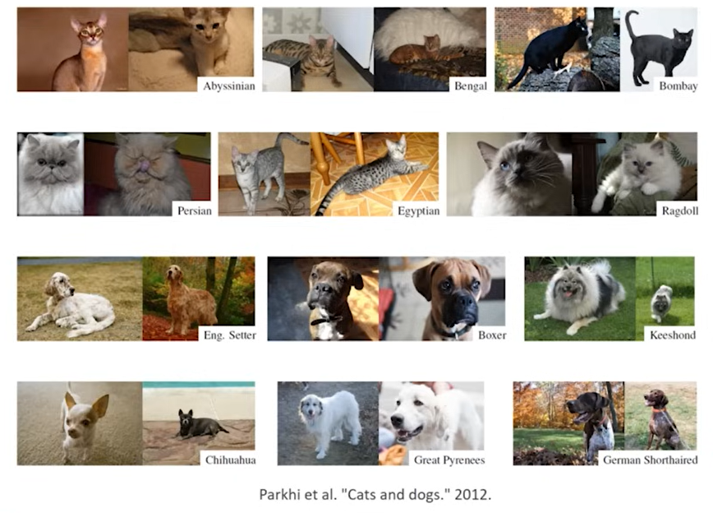
Intra-class Variability

Slide 15
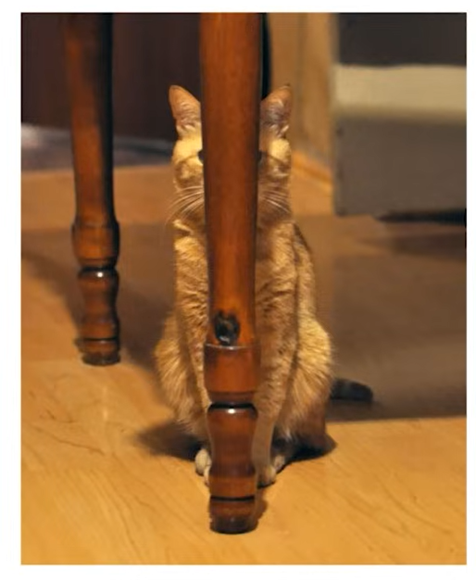
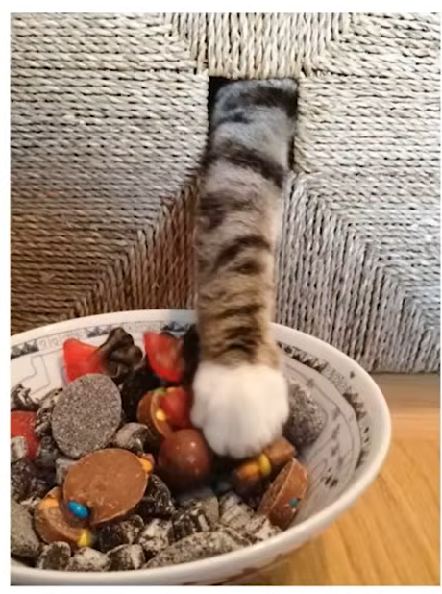
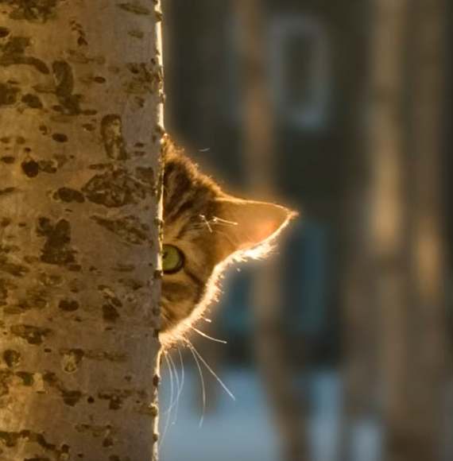
Occlusion
Occlusion refers to scenarios where another object hides or blocks part of an object
Notes:
“Techniques like Robust Principal Component Analysis (RPCA) can help separate an image’s background and foreground, potentially making occluded objects more distinguishable.

Slide 16
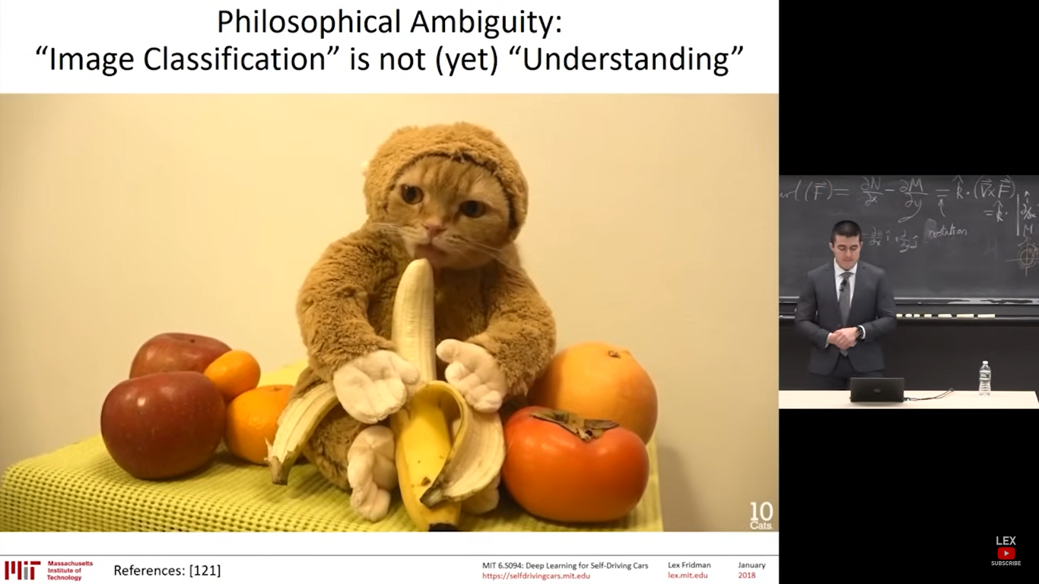
Philosophical Ambiguity (“Image Classification” is not yet “Understanding”)
Humour of the situation: Cat dressed like a monkey and eating a banana + contextual understanding
Presentations are communication tools that can be used as demonstrations.

Slide 17
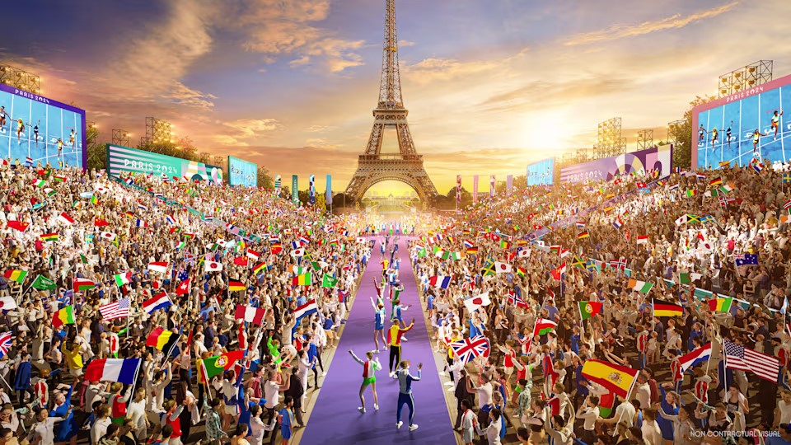
Contextual understanding
Computer vision systems often need help with understanding context. They can identify individual objects in an image, but understanding the relationship between them and interpreting the scene can be problematic.
Notes:
Lot of research is happening in this area.

Slide 18
Philosophical Ambiguity (“Image Classification” is not yet “Understanding”)
Humour of the situation: Cat dressed like a monkey and eating a banana + contextual understanding

Slide 19
Lack of annotated data
Training computer vision models necessitates a substantial amount of annotated data. Image annotation, a critical component of training AI-based computer vision models, involves human annotators structuring data.
Lot of work is going on.
e.g., Driving datasets for India
Medical disease related datasets specific to India
Genomics data
Notes:
Techniques such as Data Augmentation, Semi-supervised learning, Unsupervised learning

Slide 20
Text Books and References
Text Books
Richard Szeliski. ”Computer vision: Algorithms and Applications. Springer Nature, Second Edition”, 2022
E. R. Davies, Computer Vision Principles, Algorithms, Applications, Learning, Elsevier,5th Edition, 2017
References
Rafael C. Gonzales, Richard E. Woods, “Digital Image Processing”, Fourth Edition, Pearson Education, 2018.
Richard Szeliski ,”Computer Vision: Algorithms and Applications” , Springer 2015
Intro to Digital Image Processing
Digital Image Processing 2nd edition
Credits: Slides and Video content borrowed from:
First Principles of Computer Vision
https://robotacademy.net.au/
MIT 6.S094: Computer Vision
MIT Introduction to Deep Learning | 6.S191
Digital Image Processing 2nd edition
PDF online

Slide 21
Lab Experiments
# | Lab Experiments:
1 | Write a program to compute the histogram of an input image and equalization of the histogram
2 | Write and execute programs to remove noise using spatial filters
 | (a) Understand 1-D and 2-D convolution process
 | (b) Use 3*3 mask for low and high pass filter
3 | Write a program to add noise in the image and apply image restoration technique using Wiener ﬁlter and median filter
4 | Write a program for Geometric transformations that shows image rotation, scaling, and translation
5 | Write a program for Determination of edge detection using operators
6 | Write a program to identify edges in image using hough transform
7 | Write a program to formulate a 2D signal processing description of images including filtering procedures, discrete approximations of the gradient operator, gaussian filtering, image pyramids, and image warping
8 | Write a program to implement motion estimation algorithms and image warping to perform basic image alignment.
9 | Write a program to formulate an appearance based recognition algorithm using principle components analysis
10 | Write a program to formulate a feature-based recognition algorithm using feature vectors computed around key points
11 | Write a program to formulate statistical pattern recognition algorithms for automated understanding of visual scenes
12 | Implement Object tracking using OpenCV
13 | Write a program to implement Face Recognition System
14 | Write a program to develop vehicle anomaly detection in video surveillance

Slide 22
Mode of Evaluation + Assignments
Theory (75%)
Continuous Assessment Test-1 15
Continuous Assessment Test-2 15
Digital Assignments/Quizzes (Min) 30
Final Assessment Test 40
Laboratory (25%)
Assignments:
a lot of programming in OpenCV.
hours and hours of programming.
days and days of debugging.
Participation:
Be around for lectures.
Ask and answer questions.

Slide 23
Contact information
Feel free to email me on venugopal.g@vitap.ac.in or reach me at Cabin#: 165
Please use [Computer Vision] in email title!

